Slide 1
Email
Password
Create account
Next

Slide 2
Menu
Your leave
leave
Employees
Positions
Department
Ronan
Header
Profile
Logout
Main

Slide 3



Your leave
leave
Employees
Positions
Department
Ronan
Profile
Logout
It is possible to filter
Department by name
Search
Department
+
Create
Create a NEW department
Training and education team
External relationship team
On hover: display EDIT and
REMOVE actions
Admin and finance team
Selection team
Remove Item ?
Are you sure you want to remove the selected department?
DON’T REMOVE
REMOVE

Slide 4
Edit department
Create department
Department name
Department name
DISCARD
UPDATE
DISCARD
CREATE

Slide 5
Your leave
leave
Employees
Positions
Department
Ronan
Profile
Logout
It is possible to filter
Position by name
Search
Position
+
Create
IT admin
WEB coordinator
WEB trainer
IT admin
Remove Position ?
Are you sure you want to remove the selected position?
DON’T REMOVE
REMOVE

Slide 6
Edit position
Create position
Position name
Position name
DISCARD
UPDATE
DISCARD
CREATE

Slide 7
Create position
General Manager
The position already exists
DISCARD
CREATE

Slide 8
Your leave
leave
Employees
Positions
Department
Ronan
Profile
Logout
It is possible to filter
Employee by either :
First name
Last name
Department
position
Search
+
Create
Create a NEW employee
Employee
First name
Last name
Department
Position
Start date
Jack
Thomas
Training / Education
IT Admin
25/05/2005
On hover : display EDIT and REMOVE actions
Ronan
Ogor
Training / Education
WEP Coordinator
25/05/2005
Seiha
Sam
Training / Education
WEP Trainer
25/05/2005
Jack
Thomas
Training / Education
IT Admin
25/05/2005

Slide 9

Create employee
First name
Last name
Department
Position
Start date
DISCARD
CREATE

Slide 10
Your leave
leave
Employees
Positions
Department
Ronan
Profile
Logout
My information
First name
Ronan
First name
OGOR
Department
Training and education
Position
WEP Coordinator
Manger
Ronan
Start date
25/11/2019
Close
This is a pop up!

Slide 11
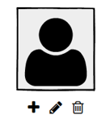
Create employee
First name
Last name
Department
Position
Start date
DISCARD
CREATE

Slide 12
Update profile popup
My information
First name
Ronan
First name
OGOR
Department
Training and education
+
Position
WEP Coordinator
Manger
Ronan
Start date
25/11/2019

Slide 13

Search
+
Create
Employee
First name
Last name
Department
Position
Manager
Start date
Jack
Thomas
Training / Education
IT Admin
Ronan
25/05/2005
Ronan
Ogor
Training / Education
WEP Coordinator
25/05/2005
Ronan
Seiha
Sam
Training / Education
WEP Trainer
Ronan
25/05/2005
Jack
Thomas
Training / Education
IT Admin
Ronan
25/05/2005

Slide 14
Update profile popup
My information
First name
Ronan
First name
OGOR
Department
Training and education
+
Position
WEP Coordinator
Manger
Ronan
Start date
25/11/2019

Slide 15
Create employee
First name
Last name
Department
Position
Manager
Start date
DISCARD
CREATE

Slide 16
Edit employee
First name
Last name
Department
HR or ADMIN only
Position
Manager
EMPLOYEE
HR OFFICER
ADMIN
Start date
ADMIN only
Role
DISCARD
CREATE

Slide 17
Search
Your Leave requests
+
Request a leave
Start date
End date
Duration
Type
Status
25/05/2005
25/05/2005
1 day
Vacation
Requested
25/05/2005
25/05/2005
2 days
Training
Cancelled
25/05/2005
25/05/2005
0.5 day
Vacation
Rejected
25/05/2005
25/05/2005
1 day
Vacation
Accepted

Slide 18
Create requests
Start Date
MORNING
End Date
MORNING
Duration : 3 day
MORNING
comment
DISCARD
SUBMIT

Slide 19
Your leave
leave
Employees
Positions
Department
Ronan
Manager see ONLY
the request of employee
managed by him/her
Search
Leave requests submitted to me
Admin and HR see all
Start date
End date
Duration
Type
25/05/2005
25/05/2005
1 day
Vacation
Accept
Reject
25/05/2005
25/05/2005
2 days
Training
Rejected
25/05/2005
25/05/2005
0.5 day
Vacation
Accept
Reject
25/05/2005
25/05/2005
1 day
Vacation
Accepted

Slide 20
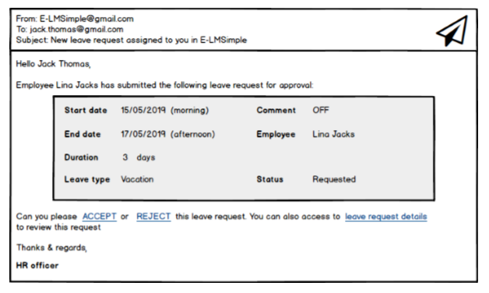

Slide 21
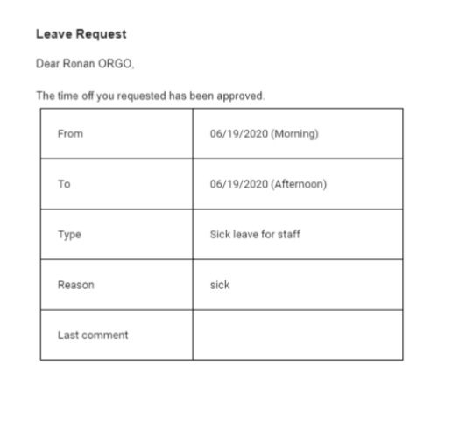

Slide 22
Search
+
Create
Employee
First name
Last name
Department
Position
Start date
Jack
Thomas
Training / Education
IT Admin
25/05/2005
Ronan
Ogor
Training / Education
WEP Coordinator
25/05/2005
Reactive
Seiha
Sam
Training / Education
WEP Trainer
25/05/2005
Jack
Thomas
Training / Education
IT Admin
25/05/2005
Reactive

